Slide 1
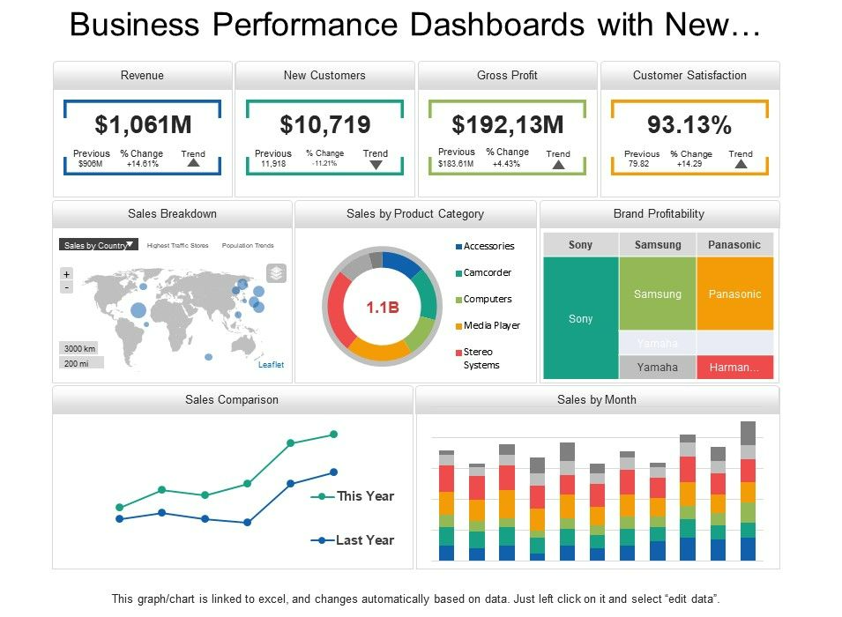
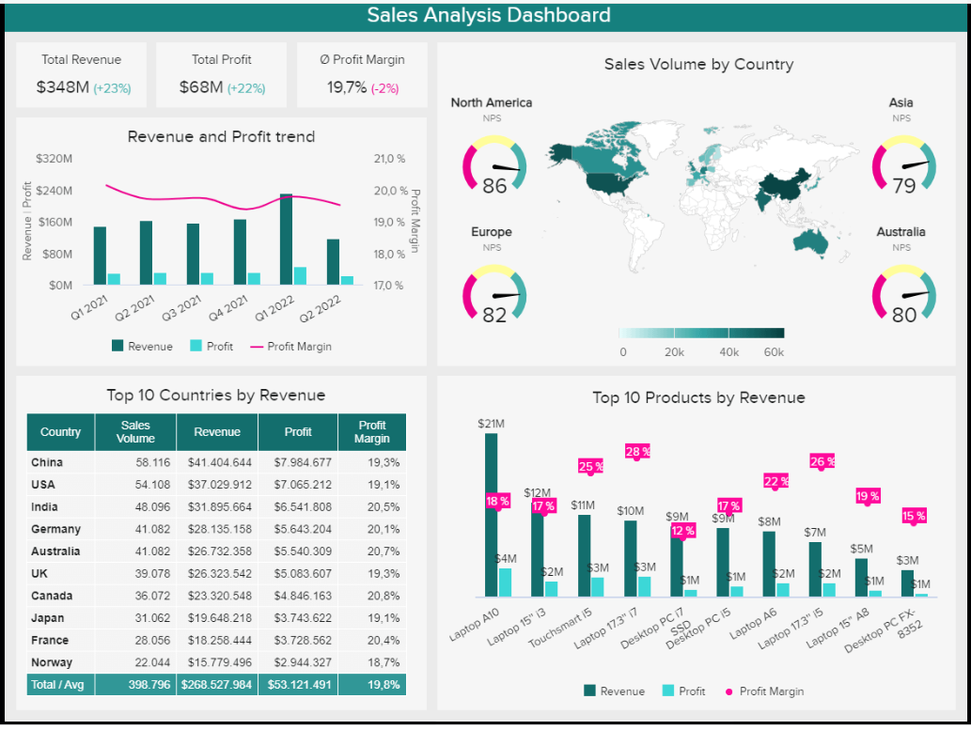
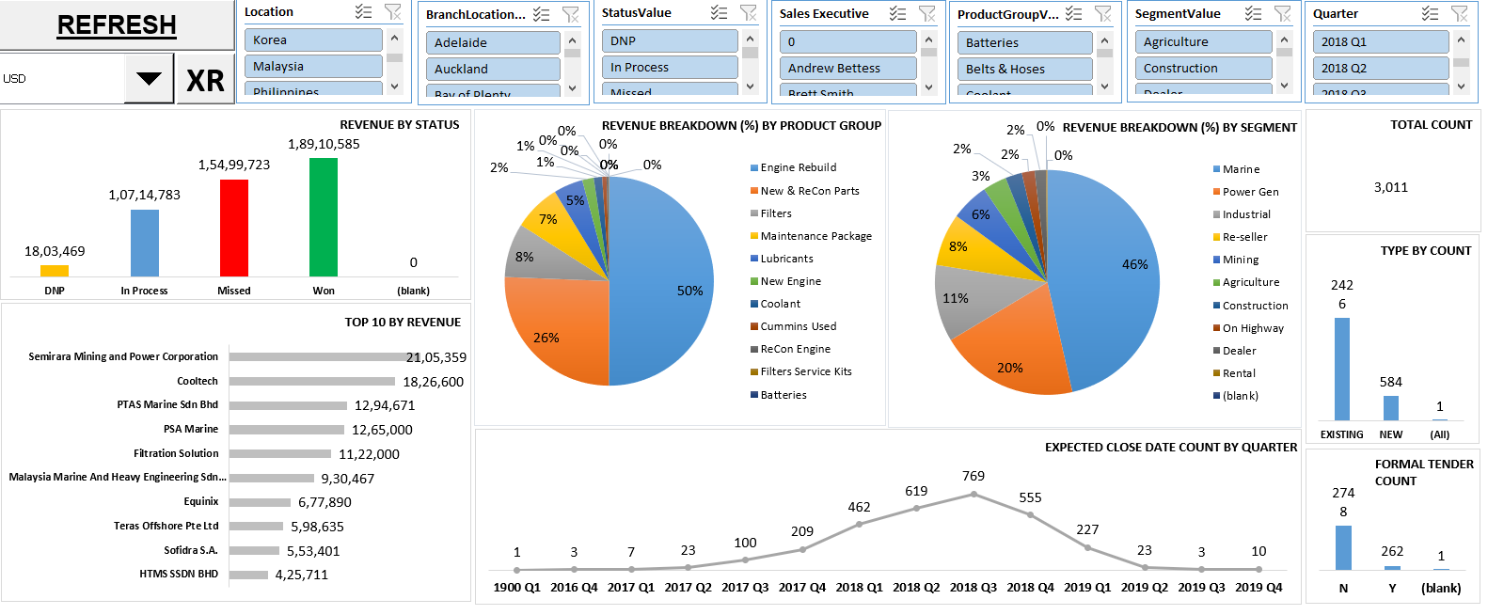
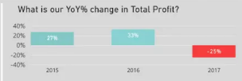
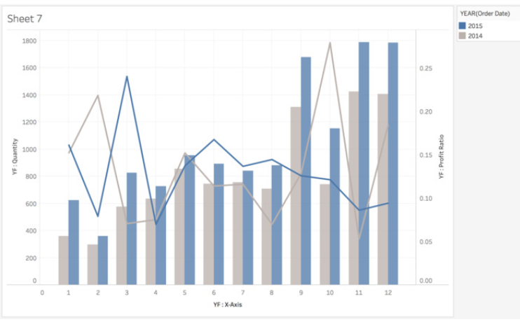
Revenue
Gross Profit
Operating unit Revenue
Business Unit
On- highway | Revenue: Margin:
Off- Highway | Revenue: Margin:
Prototype | Revenue: Margin:
CES UK OPERATING UNIT
Revenue Breakdown% by Account
Profit Breakdown% by Account
CES US Operating Unit
Total Order Quantity
xxxxxx
Accounts-E
CES Juarez Operating Unit
Average Order Quantity
xxxx
CES Germany Operating Unit
Quarters-S
% Change Price
H2 2023 Vs H1 2023: XX
Model Year by Revenue
WPT by Revenue
% Change Price
H1 2023 Vs 2022: XX
Customers-F
Impact
H2 2023 Vs H1 2023:
Pricelists-AE
Last year revenue with current year revenue month wise on bar. Margins on line chart
Account Profitability
Top 10 Customers
Top 10 Item numbers
Sales Manager-I
Model Series-Z

Slide 2
Revenue= AY1/1000000
GROSS MARGIN= BE1/1000000
Revenue-
Gross Margin
PREVIOUS= (BB1)/1000000
% CHANGE=(BE1-BB1)/BB1
Revenue Breakdown% by Account
Weighted Margin Breakdown% by Account
Weighted Margin Breakdown% by Account using column BU & BX
PREVIOUS= AU1/1000000
% CHANGE=(AY1-AU1)/AU1
Revenue Breakdown% by Account USING COLUMN E & AY
Model Year by Revenue
WPT by Revenue
WPT by Revenue USING COLUMN W & AY
Model Year by Revenue USING COLUMN X & AY

Slide 3
USING COLUMN AV & AY FOR REVENUE BARS
COLUMN BA & BE FOR LINE CHART
USING COLUMN E & BE
Account Profitability
Last year revenue with current year revenue month wise on bar. Margins on line chart

Slide 4
Operating unit Revenue
CES UK OPERATING UNIT
USING COLUMN A & AY
CES US Operating Unit
USING COLUMN F & AO & AY & BE
CALCULATE PROFIT MARGIN
CES Juarez Operating Unit
USING COLUMN AZ, BA, BE
CES Germany Operating Unit
USING COLUMN V & AY & BE
CALCULATE PROFIT MARGIN
Top 10 Customers
Top 10 Item numbers

Slide 5
Business Unit
On- highway | Revenue: Margin:
Off- Highway | Revenue: Margin:
Prototype | Revenue: Margin:
Total Order Quantity
xxxxxx
Accounts-E
USING COLUMN AO
Average Order Quantity
xxxx
USING COLUMN AO
Quarters-Q
% Change Price
H2 2023 Vs H1 2023: XX
USING CELL BL1
USING CELL BM1
Customers-F
% Change Price
H1 2023 Vs 2022: XX
USING CELL BN1
Pricelists-AC
Impact
H2 2023 Vs H1 2023:
Sales Manager-I
Model Series-X

